Slide 1
6.1 Automated systems
Automated systems – Part 1

Slide 2
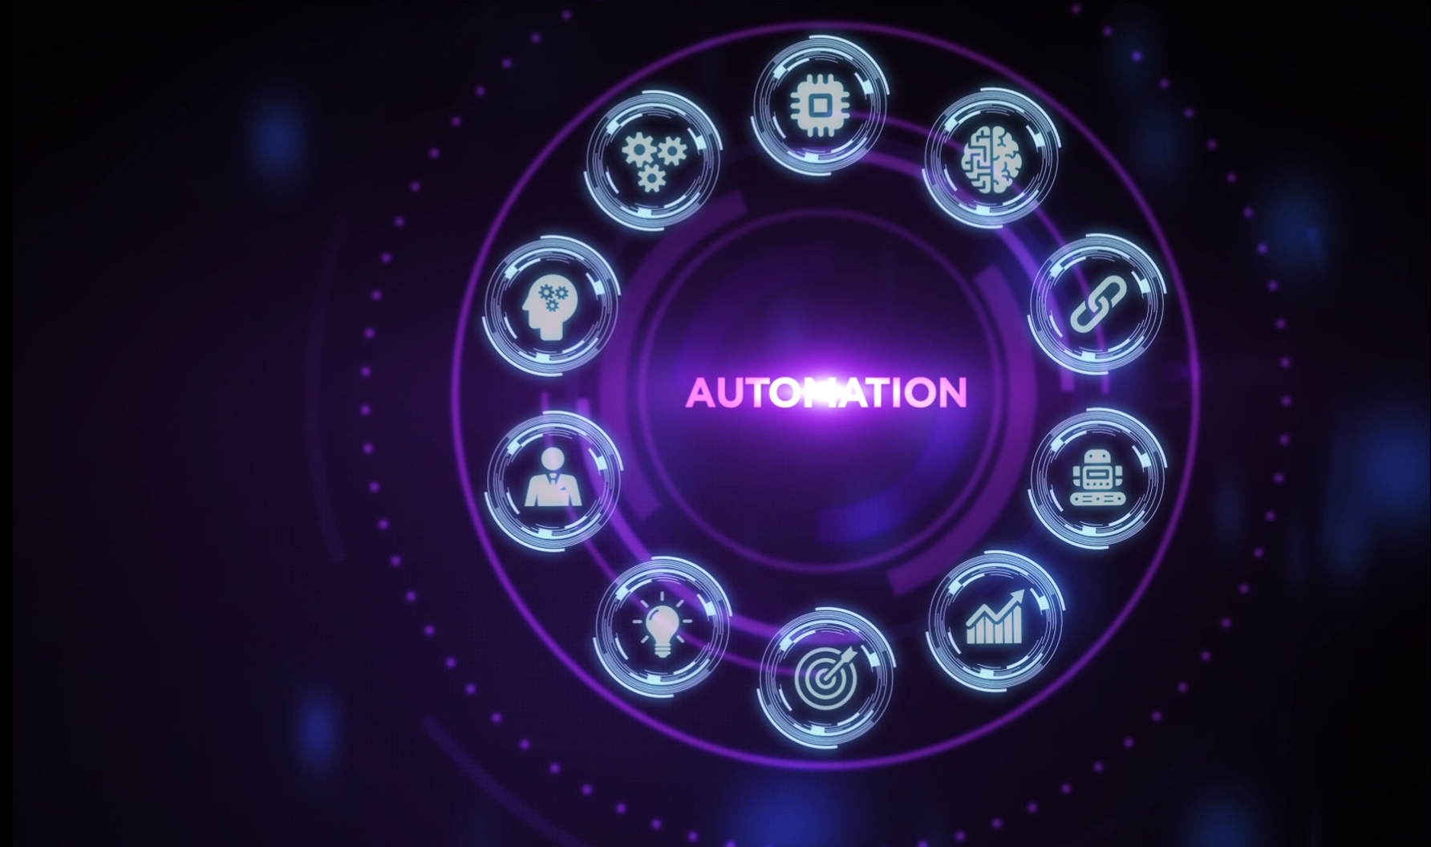
Automated systems
Technology has led to great advancements in automated systems that require little to no human interaction.
Automation is used in many areas including:
Industry
Transport
Agriculture
Weather
Gaming
Lighting
Science

Slide 3

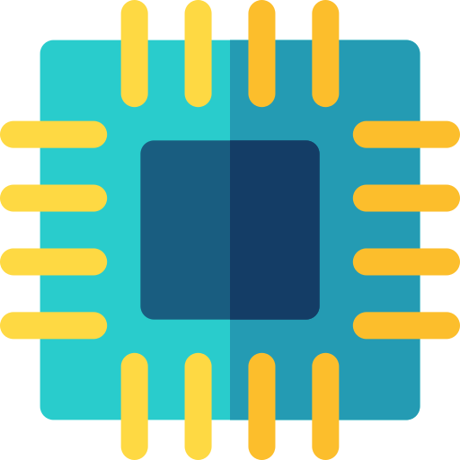


Automated systems
Automated systems usually comprise three distinct components.
Sensors
Microprocessors
Actuators

Slide 4

Automated systems
A vast array of different sensors exist – they are used to take measurements from their environmental surroundings.
Acoustic
Accelerometer
Flow
Gas
Humidity
Infrared
Level
N
S
Light
Magnetic field
Moisture
pH
Pressure
Proximity
Temperature
We look at sensors in a lot more detail in the following videos:
3.2 Sensors - Part 1
3.2 Sensors - Part 2

Slide 5



Automated systems
Sensors provide these measurements as inputs to microprocessors, which then process the information and make decisions based on predefined rules.
N
S

Slide 6
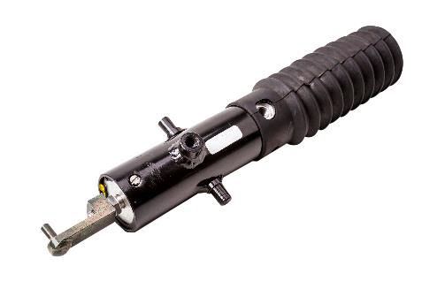
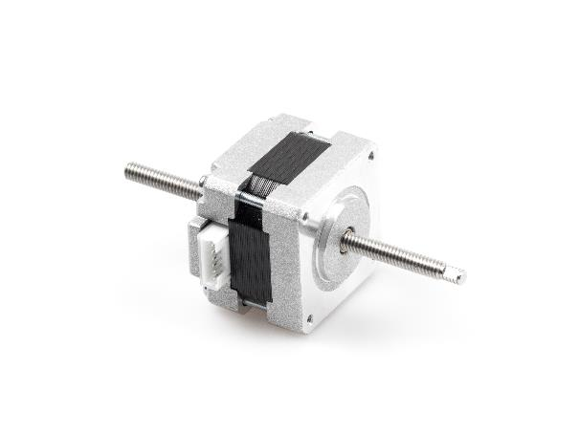
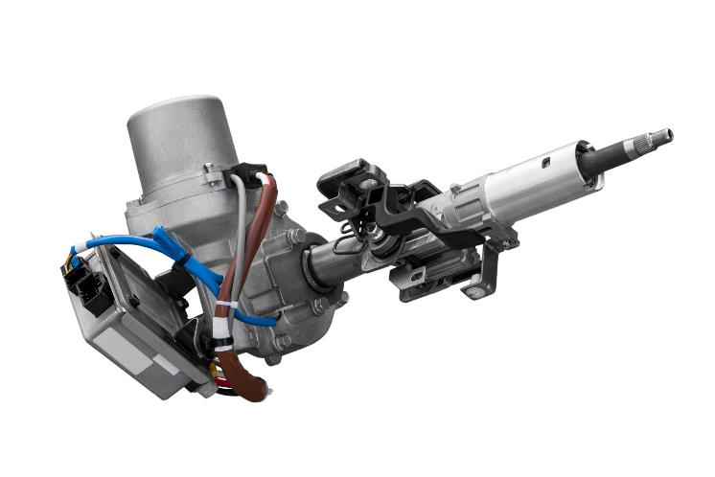
Automated systems
Decisions made by microprocessors typically result in instructions to control an actuator and make physical changes – e.g., activating an alarm, opening or closing a door or valve, etc.

Slide 7


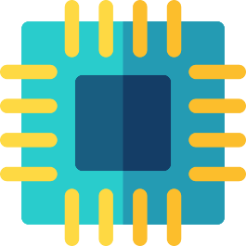
Feedback
These components are often used to create a feedback loop where changes (outputs) from the automated system affect the following set of input values received from the sensors.
.
.
.

Slide 8

Automated systems
Automated systems usually comprise three distinct components:
Sensors
Microprocessors
Actuators
Sensors take measurements from their environmental surroundings.
Sensor measurements are fed in as inputs to microprocessors, which then process the information and make decisions.
Decisions made by microprocessors typically result in instructions to control an actuator and make physical changes – e.g., activating an alarm, opening or closing a door or valve, etc.

Slide 9


